Slide 1
WALK A MILE IN THEir SHOES
STAND UP! SPEAK OUT
STOP BULLYING

Slide 2
WHAT IS BULLYING?
Bullying is any repeated, systematic pattern of gestures, written or electronic, verbal communication, or ANY physical act , threatening communication confiscation of items, money, electronics, clothes, shoes and hats.
Bullying creates a hostile environment and interferes with or impairs a student’s legal rights to an equitable and safe education.

Slide 3
TYPES OF BULLYING
Physical Bullying is any unwanted physical contact between the bully and the victim.
Punching
Shoving
Kicking
Teasing
Pushing
Headlocks
Emotional Bullying is any form of bullying that causes damage to a victim’s psyche and/or emotional well-being.
Spreading cruel rumors about people
Ganging up on an individual (MOB ACTION)
Harassing an individual

Slide 4
TYPES OF BULLYING
Verbal Bullying is making slanderous statements or accusations that cause the victim undue emotional discomfort.
Directing foul language (PROFANITY) at the targeted student
Commenting negatively on someone’s looks, clothes, body etc.
Tormenting
Harassing
Spreading rumors
Teasing someone based on gender and/or sexual preference
Cyber Bullying is any bullying using technology.
Abuse using email
Sending harassing text messages
Harassing postings on Facebook, Twitter, Instagram

Slide 5
STATISTICS
83% of girls and 79% of boys report Bullying
6 out of 10 teenagers say they witness Bullying in school daily
It is estimated that 160,000 children miss school every day due to fear of attack or intimidation by other students
35% of kids have been threatened online
75% of school shootings have been linked to bullying
1 out of every 10 students who drop out of school do so because of bullying
Over 14% of high school students who have been Bullied have considered suicide and 7% have actually attempted suicide
Bullyingstatistics.org

Slide 6
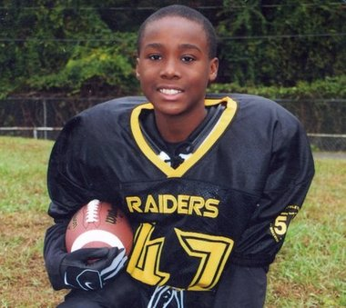
BULLYING TRAGEDY
Amanda Todd 15 Years Old
Carl Walker Hoover 11 Years Old

Slide 7
LIVE FEED
http://schoolsofthought.blogs.cnn.com/2012/10/12/bullied-canadian-teen-leaves-behind-chilling-youtube-video/
http://www.youtube.com/watch?v=N9-geNtTzN8

Slide 8
ARE YOU BEING BULLIED?
What can you do?
Speak up against bullying
Walk away
Tell an adult you trust
Do not hurt yourself
Tell a teacher, school counselor and/or administrator

Slide 9
Consequences Of Bullying
Short Term Suspension
Long Term Suspension
Expulsion
State and Federal Laws to address Bullying
Possible Imprisonment if bullying causes suicide

Slide 10
QUESTIONS?

